Slide 1

Business Statistics, 5th ed. by Ken Black
Chapter 8
Statistical Inference: Estimation for Single Populations
PowerPoint presentations prepared by Lloyd Jaisingh, Morehead State University

Slide 2
Learning Objectives
Know the difference between point and interval estimation.
Estimate a population mean from a sample mean when σ is known.
Estimate a population mean from a sample mean when σ is unknown.
Estimate a population proportion from a sample proportion.
Estimate the minimum sample size necessary to achieve given statistical goals.
Notes:
2

Slide 3
Statistical Estimation
Point estimate -- the single value of a statistic calculated from a sample which is used to estimate a population parameter
Interval Estimate -- a range of values calculated from a sample statistic(s) and standardized statistics, such as the z
  Selection of the standardized statistic is determined by the sampling distribution.
  Selection of critical values of the standardized statistic is determined by the desired level of confidence.
Notes:
3

Slide 4
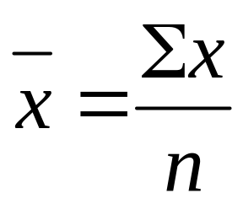
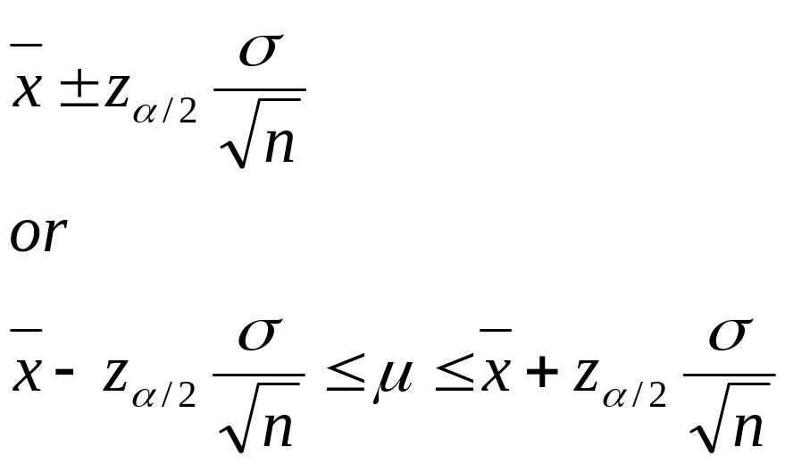
100×(1 - α)%Confidence Interval to Estimate μ when σ is Known
Point estimate
Interval Estimate
Notes:
4

Slide 5
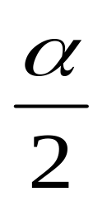
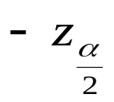
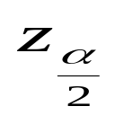
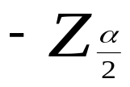
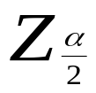
Distribution of Sample Means for (1-α)% Confidence
1−α
μ
X
Z
0
Notes:
5

Slide 6
Distribution of Sample Means for 95% Confidence
.025
.025
95%
.4750
.4750
μ
X
Z
-1.96
0
1.96
Notes:
9

Slide 7
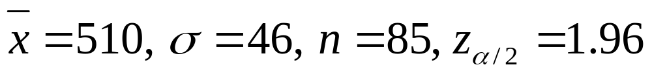
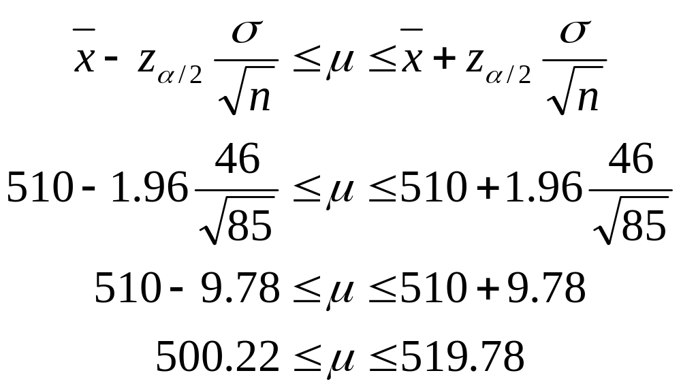
95% Confidence Interval for μ
Notes:
10

Slide 8
Demonstration Problem 8.1
A survey was taken of U.S. companies that do business with firms in India. One of the questions on the survey was: Approximately how many years has your company been trading with firms in India? A random sample of 44 responses to this question yielded a mean of 10.455 years. Suppose the population standard deviation for this question is 7.7 years. Using this information, construct a 90% confidence interval for the mean number of years that a company has been trading in India for the population of U.S. companies trading with firms in India.

Slide 9
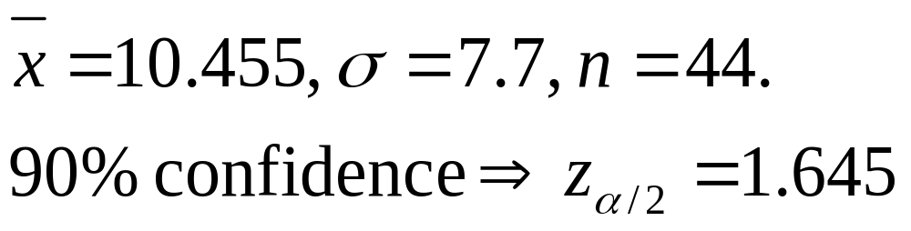
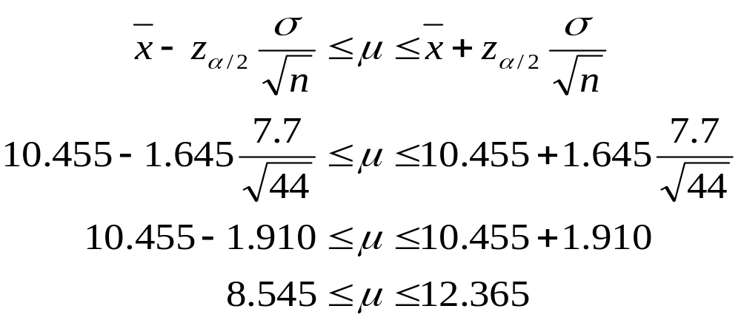
Solution of Demonstration Problem 8.1
Notes:
13

Slide 10
Demonstration Problem 8.2
A study is conducted in a company that employs 800 engineers. A random sample of 50 of these engineers revels that the average sample age is 34.30 years. Historically, the population standard deviation of the age of the company’s engineers is approximately 8 years. Construct a 98% confidence interval to estimate the average age of all engineers in this company.

Slide 11
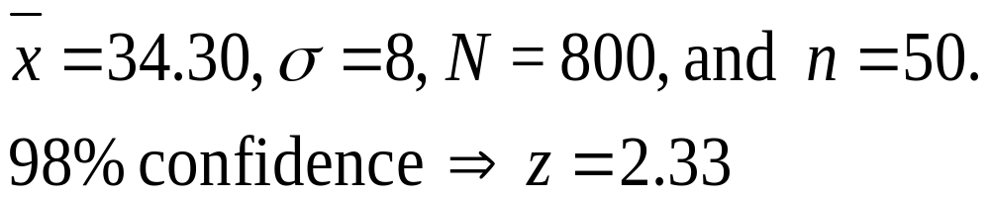
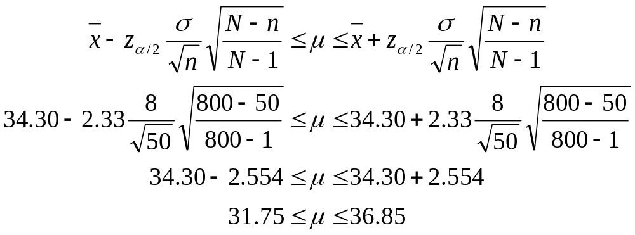
Solution of Demonstration Problem 8.2
Notes:
14

Slide 12
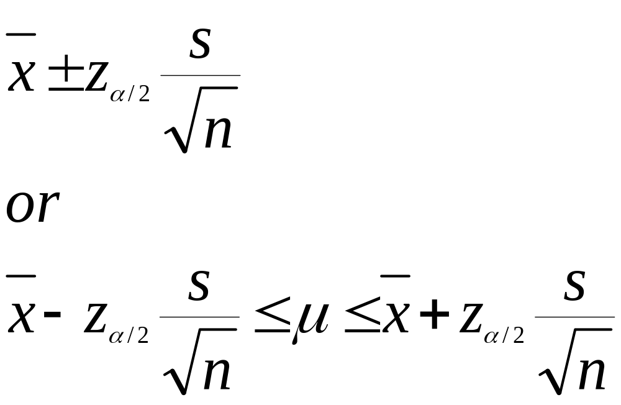
Confidence Interval to Estimate μ when n is Large and σ is Unknown
Notes:
15

Slide 13
Car Rental Firm Example
U.S. car rental firm wants to estimate the average number of miles traveled per day by each of its cars rented in California. A random sample of 110 cars rented in California reveals that sample mean travel distance per day is 85.5 miles and standard deviation is 19.3 miles. Compute a 99% confidence interval to estimate the population mean.

Slide 14
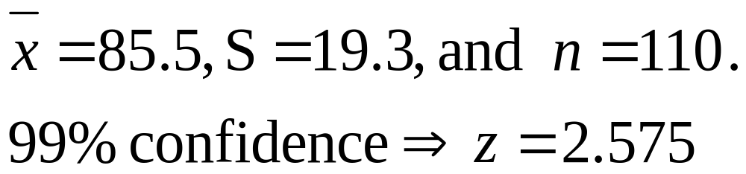
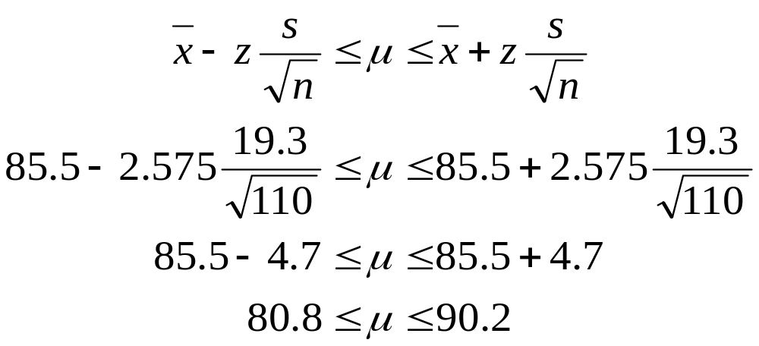
Solution of Car Rental Firm Example
Notes:
13

Slide 15
Z Values for Some of the More Common Levels of Confidence
Confidence Level
z_{α/2} Value
90%
95%
98%
99%
1.645
1.96
2.33
2.575
Notes:
17

Slide 16
Estimating the Mean of a Normal Population: Unknown σ
The population has a normal distribution.
The value of the population standard deviation is unknown.
z distribution is not appropriate for these conditions
t distribution is appropriate
Notes:
18

Slide 17
Table of Critical Values of t
t0.100
t0.050
t0.025
t0.010
t0.005
df
1
3.078
6.314
12.706
31.821
63.656
2
1.886
2.920
4.303
6.965
9.925
3
1.638
2.353
3.182
4.541
5.841
α
4
1.533
2.132
2.776
3.747
4.604
5
1.476
2.015
2.571
3.365
4.032
23
1.319
1.714
2.069
2.500
2.807
24
1.318
1.711
2.064
2.492
2.797
25
1.316
1.708
2.060
2.485
2.787
0
tα
29
1.311
1.699
2.045
2.462
2.756
30
1.310
1.697
2.042
2.457
2.750
With df = 24 and α = 0.05, t_{α} = 1.711.
40
1.303
1.684
2.021
2.423
2.704
60
1.296
1.671
2.000
2.390
2.660
120
1.289
1.658
1.980
2.358
2.617
∞
1.282
1.645
1.960
2.327
2.576
Notes:
21

Slide 18
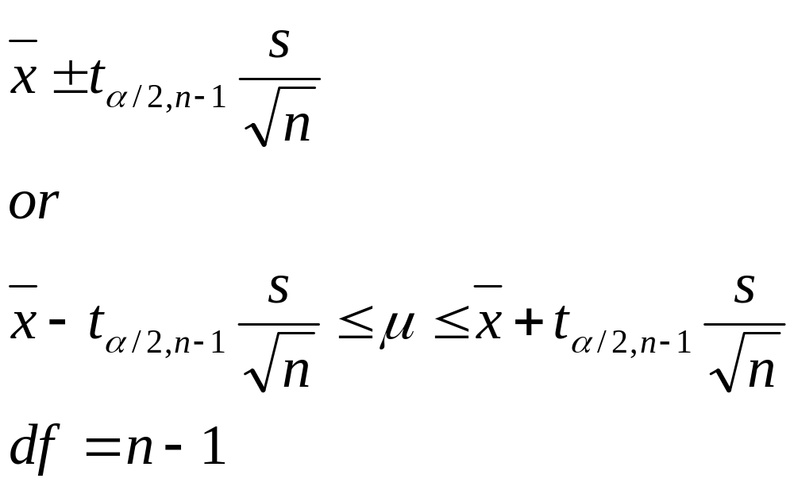
Confidence Intervals for μ of a Normal Population: Unknown σ
Notes:
22

Slide 19
Demonstration problem 8.3
The owner of a large equipment rental company wants to make a rather quick estimate of the average number of days a piece of ditchdigging equipment is rented out per person per time. The company has records of all rentals, but the amount of time required to conduct an audit of all accounts would be prohibitive. The owner decides to take a random sample of rental invoices. Fourteen different rentals of ditchdiggers are selected randomly from the files, yielding the following data. She uses these data to construct a 99% confidence interval to estimate the average number of days that a ditchdigger is rented and assueme tha the number of per rental is normally distributed in the population.
3 1 3 2 5 1 2 1 4 2 1 3 1 1

Slide 20
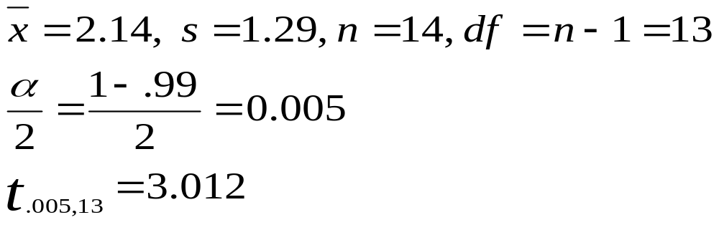
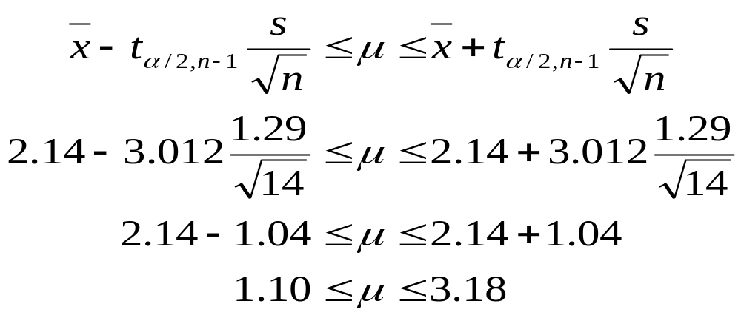
Solution for Demonstration Problem 8.3
Notes:
23

Slide 21
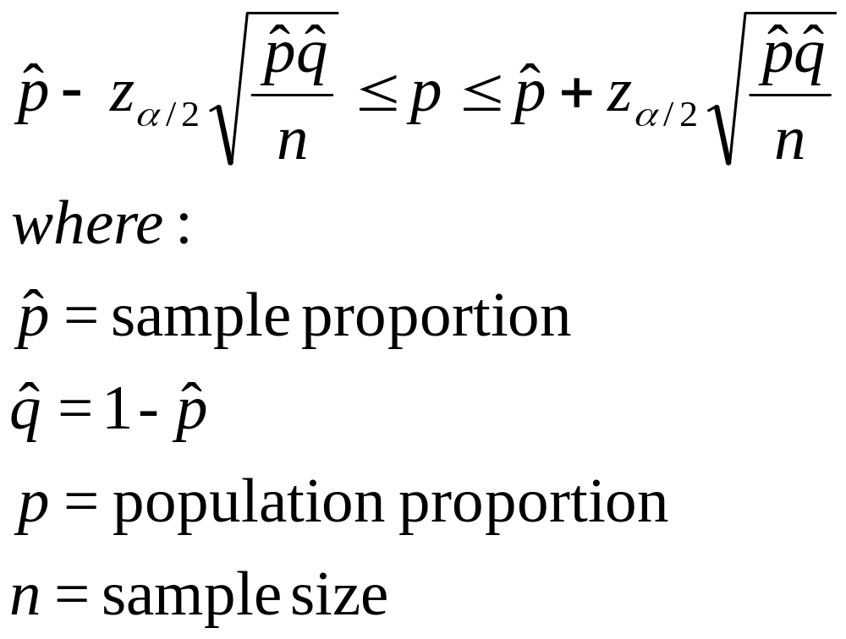
Confidence Interval to Estimate the Population Proportion
Notes:
25

Slide 22
Demonstration problem 8.5 a clothing company produces men’s jeans. The jeans are made and sold with either a regular or a boot cut. In an effort to estimate the proportion of their men’s jeans market in Oklahoma city that prefers boot-cut jeans, the analyst takes a random sample of 212 jeans from the company’s two Oklahoma city retail outlets. Only 34 of the sales were for boot-cut jeans. Construct a 90% confidence interval to estimate the proportion of the population in Oklahoma city who prefer boot-cut jeans.

Slide 23
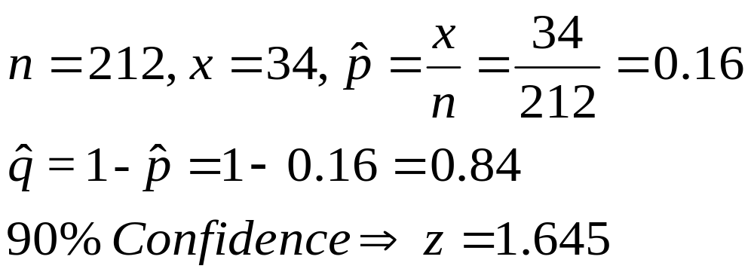
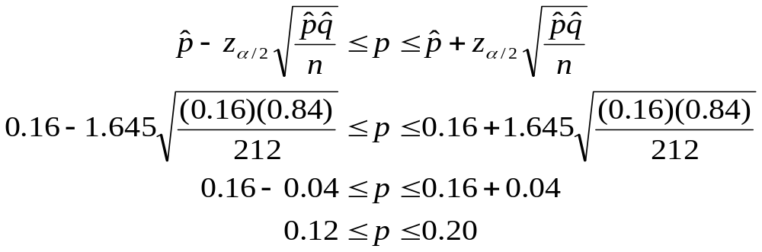
Solution for Demonstration Problem 8.5
Notes:
26

Slide 24
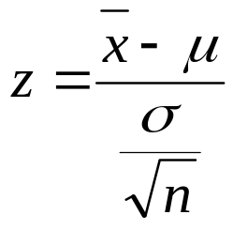

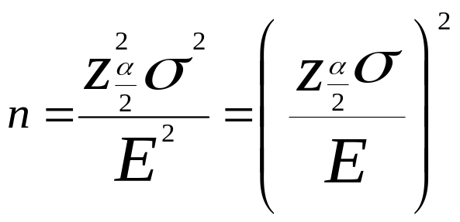
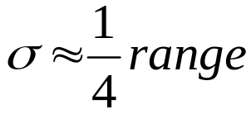
Determining Sample Size when Estimating μ
z formula
Error of Estimation (tolerable error)
Estimated Sample Size
Estimated σ
Notes:
35

Slide 25
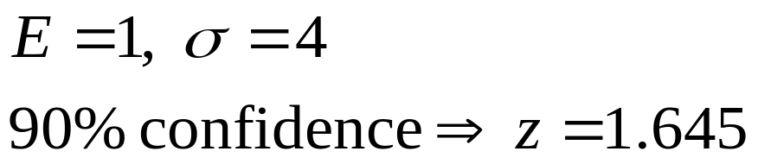
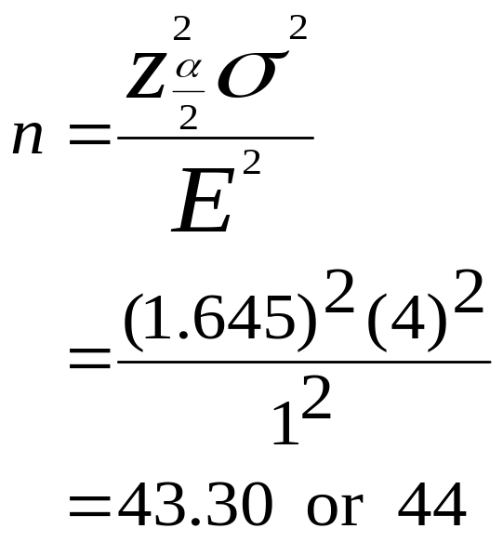
Sample Size When Estimating μ: Example
Notes:
36

Slide 26
Demonstration problem 8.7
Suppose you want to estimate the average age of all Boeing 737-300 airplanes now in active domestic U.S. service. You want to be 95% confident, and you want your estimate to be within two year of the actual figure. The 737-300 was first placed in service about 30 year ago, but you believe that no active 737-300s in the U.S. domestic fleet are more than 25 years old. How large of a sample should you take?

Slide 27
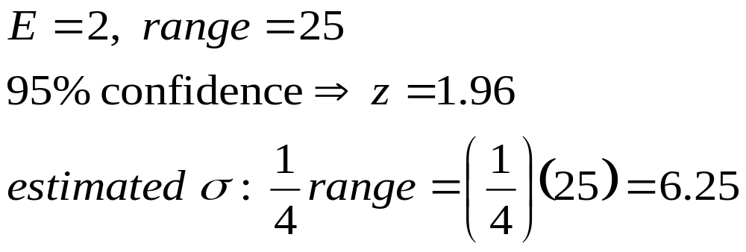
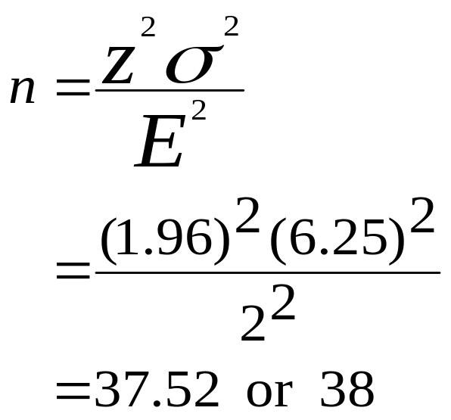
Solution for Demonstration Problem 8.7
Notes:
37

Slide 28
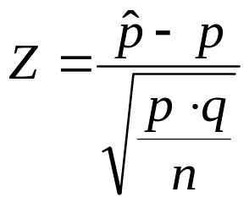

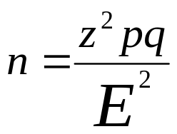
Determining Sample Size when Estimating p
z formula
Error of Estimation (tolerable error)
Estimated Sample Size
Notes:
38

Slide 29
Demonstration Problem 8.8
Hewitt associates conducted a national survey to determine the extent to which employers are promoting health and fitness among their employees. One of the questions asked was, does your company offer on-site exercise classes? Suppose it was estimated before the study that no more than 40% of the companies would answer yes. How large a sample would Hewitt associates have to take in estimating the population proportion to ensure a 98% confidence in the results and to be within 0.03 of the true population proportion?

Slide 30
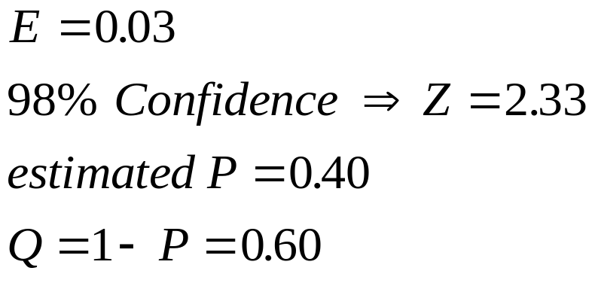
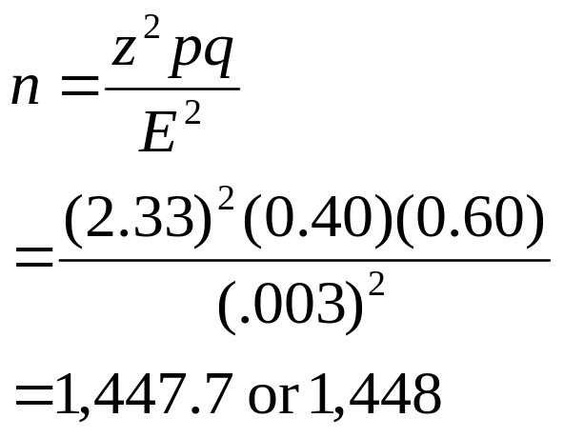
Solution for Demonstration Problem 8.8
Notes:
39

Slide 31
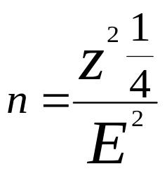
Determining Sample Size when Estimating p with No Prior Information
p
pq
z = 1.96
E = 0.05
400
0.5
0.4
0.3
0.2
0.1
0.25
0.24
0.21
0.16
0.09
350
300
250
n
200
150
100
50
0
0
0.1
0.2
0.3
0.4
0.5
0.6
0.7
0.8
0.9
1
P
Notes:
40

Slide 32
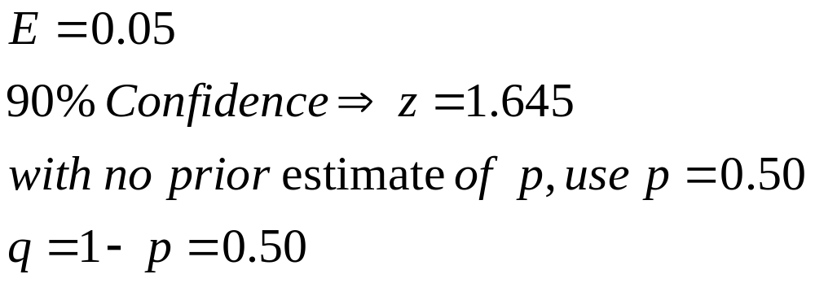
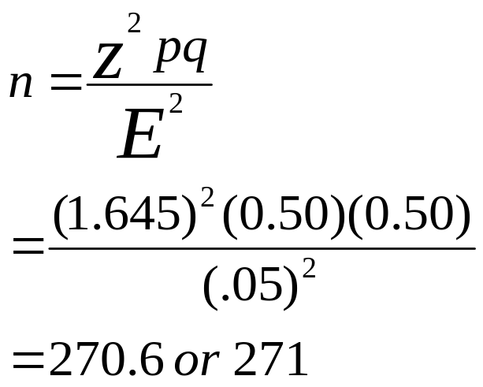
Example: Determining n when Estimating p with No Prior Information
Notes:
41

